Slide 1
eXtreme Programming
Project Planning

Slide 2
Overview
Planning problems and XP’s answer
The XP roles: customer and developer
The XP Planning Games (Initial, Release & Iteration)
  Writing stories
  Estimating effort
  Breaking down stories
  Determining iteration size
  Project velocity
  Sorting stories
  The Exploration Phase to resolve uncertainties
  The Iteration Planning Game

Slide 3
The way it’s often done
We should gather all requirements first, then plan
Only certain members of the team plan: planning requires special skills
Talk to the customer, then plan and present it
Planning is expensive, so do it infrequently. Simply track, have status reports and meetings in-between

Slide 4
The XP way
Allow explicitly for incomplete and changing requirements
Require almost constant communication amongst parties
Planning is frequent and should be inexpensive
Involve all team members, with roles made clear

Slide 5
The XP roles
XP has two basic roles:
Customer involvement in planning:
  Responsible for business decisions
  Suggest stories and prioritise them
  Willingness to discuss stories and estimates
Developer involvement in planning:
  Making best estimates possible for stories
  Informing customers of implications of various choices

Slide 6
XP Planning Games
An Initial Planning Game
  Before development team assembled
  Initial brainstorming
An exploration phase
  Includes exploration required during and after Initial Planning and during Release and Iteration Planning
  Often considered as iteration zero
Release/Iteration Planning Games
  Planning in more detail
  All developers and customer representatives are present

Slide 7
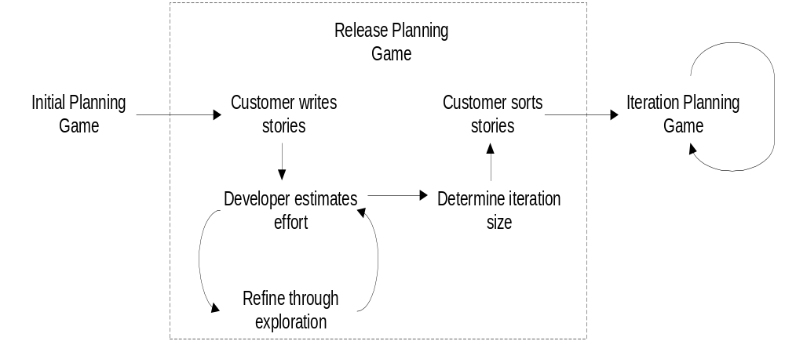
XP Planning Games (2)

Slide 8
The Planning Game process
Customer writes stories on index cards
Developer puts estimates on cards in agreed unit of measurement
Developer determines approximately how many units of measurement (M) in each N-week iteration
Customer sorts cards into piles of M units or fewer in prioritised order
  The developer can also indicate levels of risk for each story

Slide 9
Writing stories
Customer “writes” each story on a separate index card, e.g. for a work scheduling system:
  The workflow system needs to be able to record each item of work in a queue. Initially, no priorities will be assigned to work items, therefore a simple FIFO queue is sufficient.
Story is: “simplest thing that can work to make everyone in the room agree that they have a placeholder for something that needs to be done”
Customer owns stories
Customer sorts stories into three piles (later)

Slide 10
Estimating effort
Estimate in terms of “ideal engineering days” or similar
“Guessing” based on experience but consider whether lots of details or just a few, difficult or straightforward
Pair-estimate for sanity check
Indicate confidence, e.g. ? or ??
Find more accurate estimate: Elaboration Phase
Discuss with customer

Slide 11
Breaking down stories
Must be able to develop one story by one pair in one iteration
Otherwise, break story down:
  Ask customer for simplest form of story
  After that has been implemented another story can be defined to more precisely reflect user requirements
Smaller stories will provide more accurate estimates

Slide 12
Determining iteration size
Customer reviews the system at the end of each iteration
Common iteration size is two weeks
Small iterations where requirements (rapid feedback to refine stories) are volatile or productive development team
Larger iterations where requirements more stable or less productive team
Iteration size also depends on team size since each iteration must deliver a meaningful increment to functionality

Slide 13
Project velocity
Before sorting stories across iterations we need to determine project velocity: “how fast the team can implement stories in a single iteration”
For each developer:
  Obtain number of days available
  Load factor to indicate experience and external distractions
  This gives “ideal engineering days” of effort available

Slide 14
Project velocity (2)
Developer | Days available | Load factor | Ideal engineering days
Pete | 6 | 3 | 2
Chris | 5 | 4 | 1
Jon | 7 | 3 | 2
Tim | 10 | 2.5 | 4
Project Velocity |  |  | 9
I can now assign a stack of cards to next iteration that require <= 9 ideal engineering days to complete

Slide 15
Sorting stories
Customer creates three piles:
  Necessary for viable system
  Valuable, but not essential
  Not necessary, but nice
Now divide stories across iterations
  High-risk, necessary stories done first
  High-risk, valuable stories next
  Then other necessary stories
  Then valuable followed by nice stories
First release is the last iteration pile with necessary stories in it

Slide 16
Exploration Phase
Done after Initial Planning and during Release and Iteration Planning
Stories/tasks that you don’t know how to estimate:
  Lower the risk of the estimate
  Experiment with implementation options
  Increase and demonstrate understanding of problem (akin to analysis)
  To determine velocity of team
  Get processes and infrastructure set up
  Training
One day to two months

Slide 17
Iteration Planning Game
Slightly more specialised form of general planning game
Unlike Release planning, at start of each iteration:
  Demonstrate and discuss system with customer
  Discussion of next iteration scope
  Task exploration: Stories broken down into tasks, which involves design effort
  Iteration plan is verified: list of tasks are assigned to developers, highest priority first with further Exploration to resolve uncertainties

